Slide 1
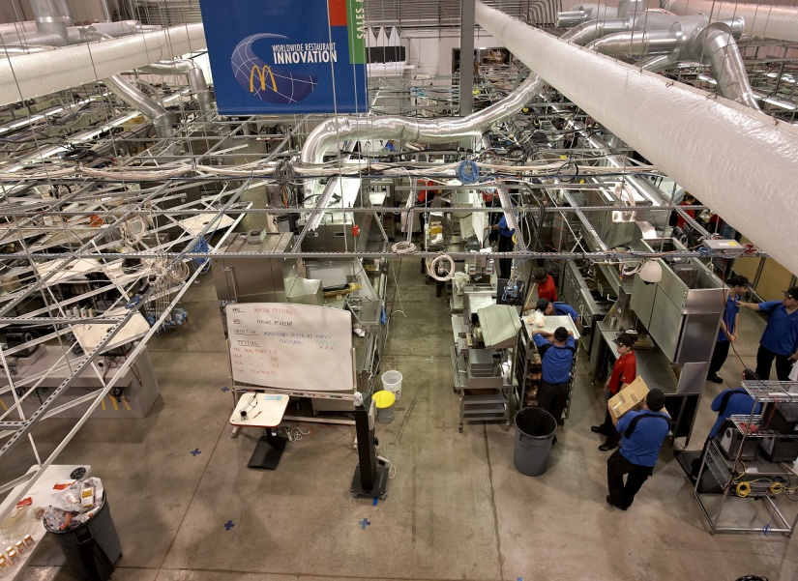
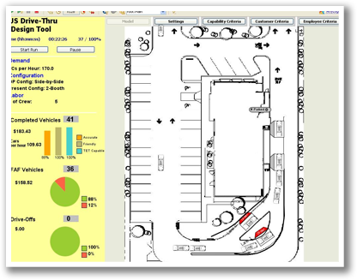
Right Tool for the Right Job
Leveraging a Suite-of-Tools Approach to Problem Solving
INFORMS Conference, 2010 November 7th, 2010
Austin, Texas,

Slide 2
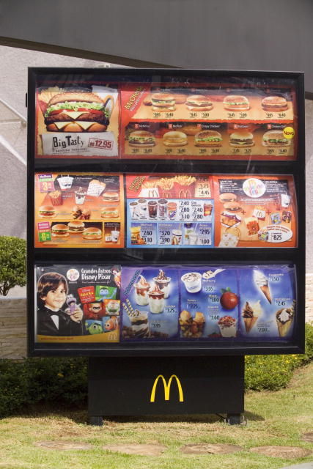
Menu
McDonald’s Today
Innovation Practices
Simulation Practices
Does that Complete your order?
Q & A

Slide 3
Nature of our Business
Pure Goods
Core Goods
Salt
Soft Drinks
Automobiles
Leasing
Cosmetics
Quick Service Restaurants
Intangible Dominant
Tangible
Dominant
Hotels
Airlines
Maid Service
Core Services
Consulting
Mutual Funds
Cooper, R; Edgett, Scott: “Product Development for the Service Sector”, Cambridge, 1999
Pure Services
Gustafsson, Anders; Johnson, Michael, D.: Competing in a service economy: hot to create a competitive advantage through service development and innovation”; university of Michigan Business School Management, John Wiley & Sons, 2003
Notes:
It’s a challenge to develop models that include both goods and services.

Slide 4
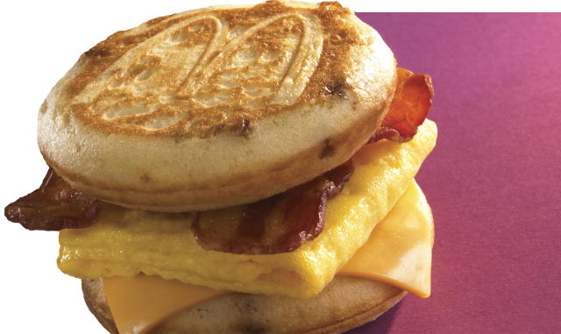
McDonald’s Today
$60+ billion System-wide sales
Record net income of $4.6 billion for 2009
  sixth consecutive year of positive comparable sales in every geographic segment
60 million customers per day
33,000 Restaurants
119 Countries
5,000+ Owner/Operators
1.7 million system employees
Notes:
Lot’s to model

Slide 5

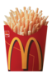
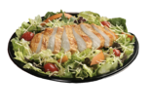
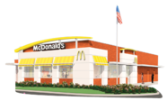
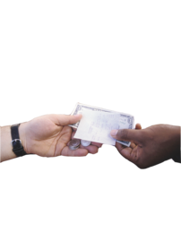
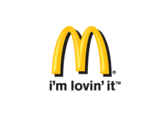
Plan to Win
New Growth Strategy…Better, Not Bigger
People
Products
Place
Price
Promotion
Notes:
McDonald’s believes Better, not bigger -> make the model better, not bigger, don’t expand models past the questions that they are good at answering

Slide 6
Menu
McDonald’s Today
Innovation Practices
Simulation Practices
Does that complete your order?
Q & A

Slide 7
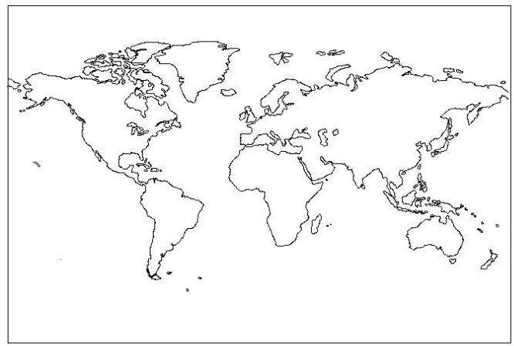
Today : Innovation Network
Notes:
Models and Simulations can come from all over the company, and we want to use the right tool for the right job.
Ex, the capability model came from Equipment and Drive-Thru teams, but we now use it for SSP
Ex, The capacity tool came from the US, and we now are contemplating how to use it as the production system in a McDOT-ISiS-Al combination.

Slide 8
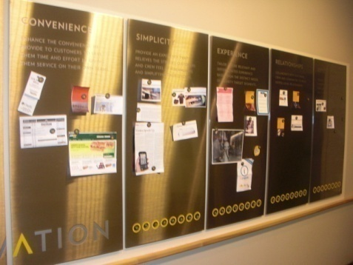
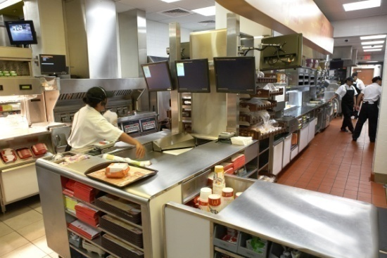
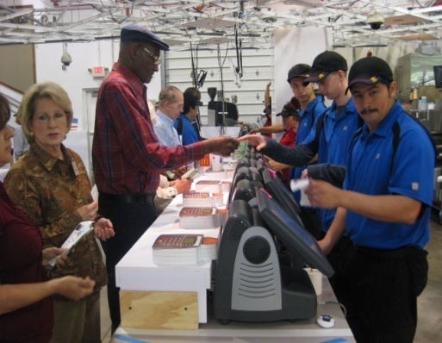
Innovation @ McDonald’s
Roles
Inspiration / Impact Thinking
Development & Testing
  System
  Component
AOW Support
  Testing / modeling
  Specific AOW project support
Notes:
As part of Innovation, our models should meet the same criteria: Inspiration/Impact Thinking, Be part of the development of new equipment, new systems, and be used in the analysis of AOQ support

Slide 9
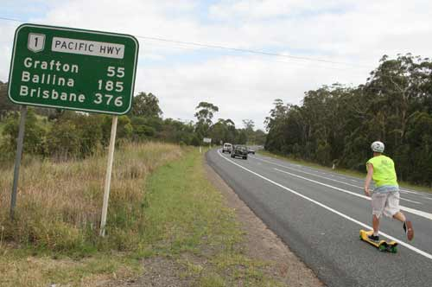
CX journey
1
Focus on the customer journey !

Slide 10

Service Design
Design for experiences that reach people through many different touch-points, and that happen over time.
Notes:
We will consider models that touch more than just the more obvious pieces of the business, they can come from any number of touch points
Ex/Mike asked Max to include signage and IEO in a demo model
Ex/Mike worked with TS to look at how to include DO/DB in our models

Slide 11
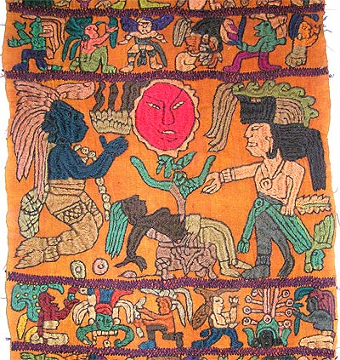
#2 Brand Ritual
2
Tell a story !

Slide 12
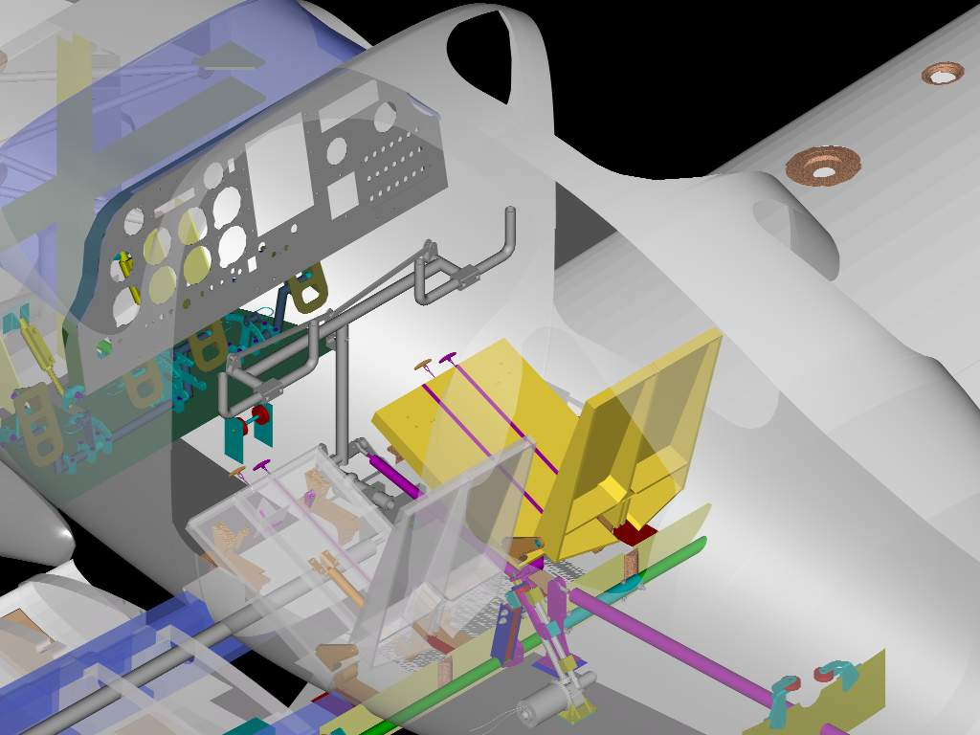
#3 System Design
3
The System, Stupid !

Slide 13
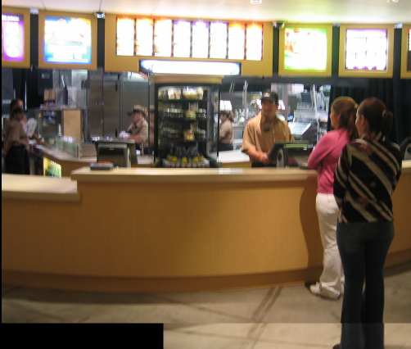
Component Design
System Design
vs.
    Specific solutions
    Detail design criteria
    Example: Counter
    System Goals
    Strategies/ Principles
    Example: Production model
Notes:
Brings us to second key topic on D10.. The path we are on -- need your help on how to talk to the system about this.
Not your typical “project” – not a linear project or straight line development path. Designing / developing a “system” as well as a series of components – balance.
For system design: we have overall system goals / criteria (outcomes)
Principles: improving quality perceptions thru designed kitchen view, simplify tasks / enrich roles, kitchen within kitchen for high/low volume, modular design.
System design includes: Footprint / backbone, service model, production model
For component design: detailed design criteria for specific solutions (i.e .holding time for 2 hours, customer control of ordering, rapid cooking of 10:1 in <30 sec)
Components – que bain, kiosk, counter top grill, mac fry station
But we go back and forth (and work on both) – system design determines what components are needed and feasibility work on components “informs” system design
Earlier this year, prelim system design and then a lot of work on critical components … some things we know how to do, some we don’t yet (rapid cooking red meat).. Component list red / yellow / green.
Now heading into a period of finalizing and beta testing system design
Romeoville concept tests, AOW Beta tests / will learn and adjust system design as well as continue to work on critical components.
Blast 3 (remainder of 2006 focus)
2007: Best tests and system refinement
Convention 2008: Launch d10. We will be asking the leadership / system to move forward with the d10 system even as not all of the “components” are available for sale. What we will have:
A system design: how to build new restaurants / remodel for d10 including flexibility, capability and quality food cues It will be validated with 3 – 6 restaurant around the world.
Our focus is being ready for that.. As I said, need your help in talking to our “system” at a system level… we are used to focusing on “things”
Let’s talk about 2007… our roadmap that moves us to the convention (Jim)

Slide 14
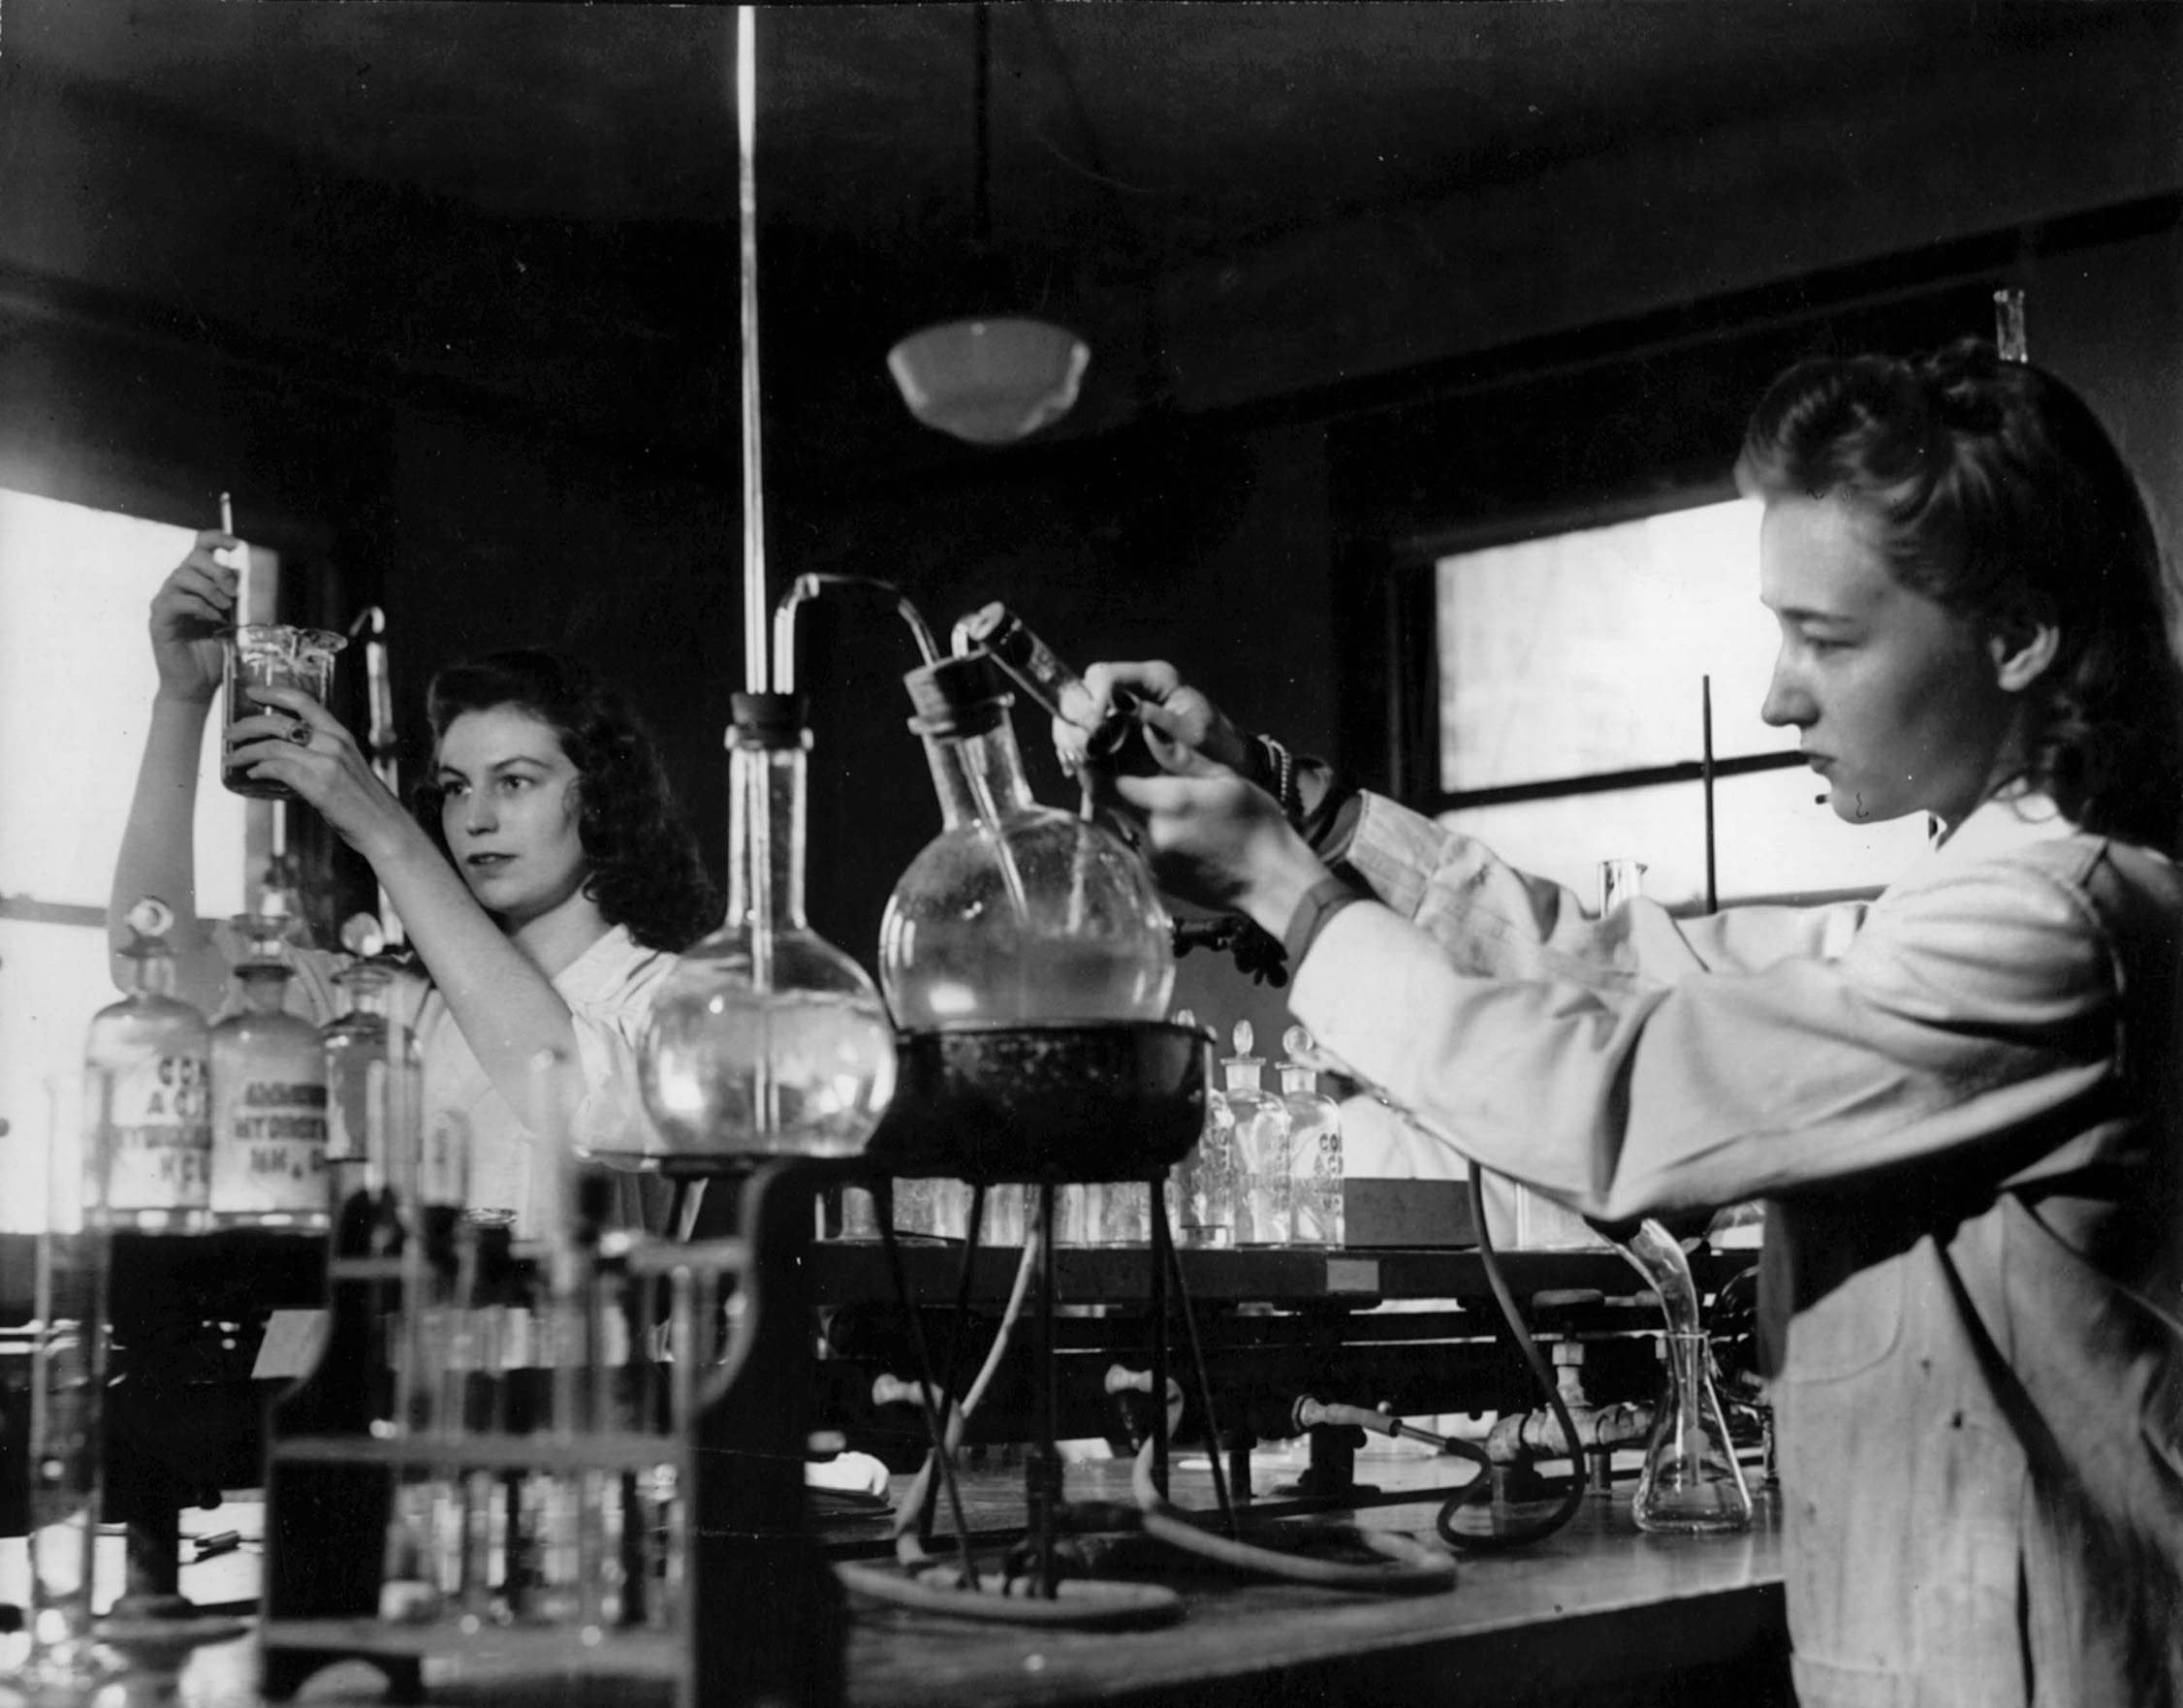
4
Experiment !

Slide 15
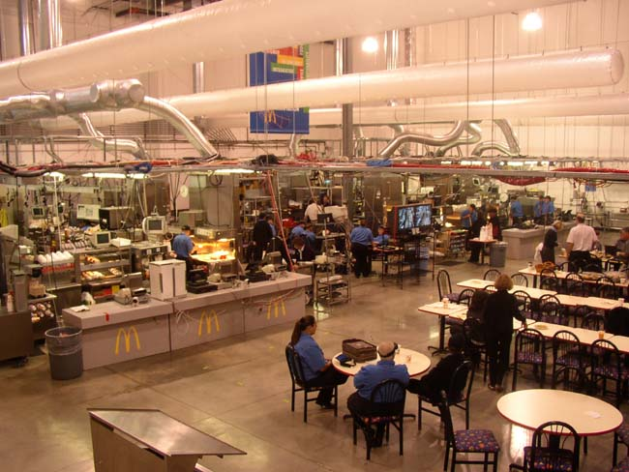
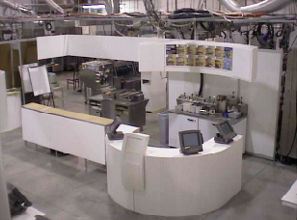
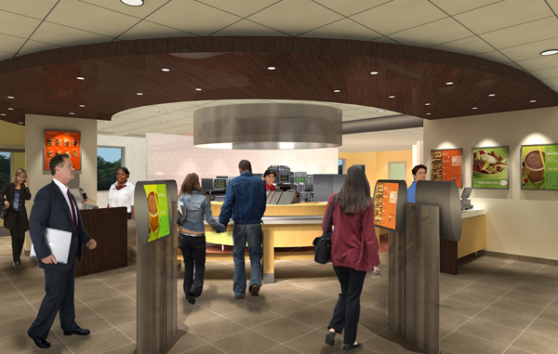
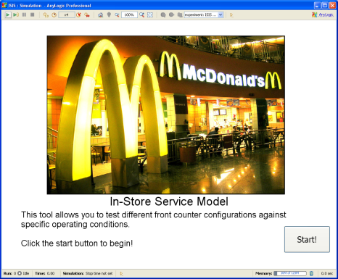
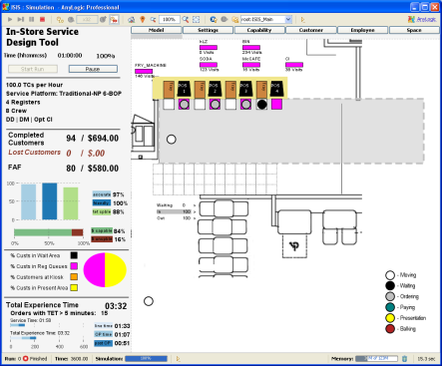
Live Simulation
Models
Pilot Store: Simulating a future store
Customer
Experience
Models
Virtual World Models

Slide 16

#5 Migration
5
Imagine Far, Plan Near !

Slide 17

Backcasting > Forecasting
Future State
Degree of
change
“back-casting”
= strategic innovation
“forecasting”
= renovation
t
Notes:
An example of a moon-shot may very well be the VIC. Just like Jerry Sus’s moon-shot, the automatic fry machine, the VIC didn’t sell as is, but it has been cannibalized for parts in the construction of McDOT/ISiS.

Slide 18
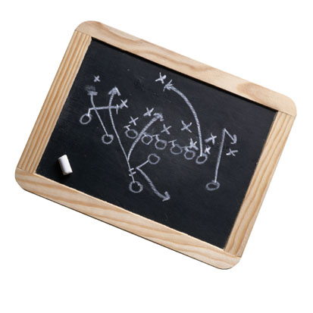
Focus on the customer journey 1
Tell a story 2
The system, stupid 3
Experiment 4
Imagine Far, Plan Near 5

Slide 19
Menu
McDonald’s Today
Innovation Practices
Simulation Practices
Does that Complete your order?
Q & A

Slide 20
IC Lab Process – Live Customer and Crew Simulator
Simulation is used to prescreen “big ideas”.
100+ hourly staff = 3 full restaurants including customers & crew
Real store transactions used as input.
Testing includes all areas of the restaurant related to process, people, product, equipment and layout
Test
Planning
Test
Execution
Data
Collection
Data
Analysis
Refine
Design
Collect & Prioritize Test Requests
Long Term Scheduling
Short Term Scheduling
Create Daily Test Plans and Objectives
Prepare Lab, Crew and Food Required
Execute Tests
Observe
Perform Recaps
Collect multiple data sets for each test
Summarize Data
Write up Learning's
Review data & observations
Consider objectives
Measure results against criteria
Form Conclusions
Determine Next Steps
Determine design changes
Modify design
Plan re-testing or send to field

Slide 21
Computer Simulation Process – Virtual World Simulator
IC lab has limited number of hours
Use Computer Simulation to search more of the solution space
Can be used by more people who aren’t give IC Lab time
With the ability to run more tests, unconventional approaches
Testing includes all areas of the restaurant related to process, people, product, equipment and layout
Design/
Source
Develop
Verify
Validate
Deploy/
Maintain
Find users
Gather requirements
Req Document
Establish inter-and intra-priorities
Spec & Schedule
RFP +/- SOW
Source Select
Create Milestones
McDonald’s housed version control
Iterate through milestones, deliverables and reviews
McDonald’s housed defect tracking
Verification test plan
Verification testing
Iterate through updates and re-tests
Validation test plan
Gather date for control scenarios
Validation testing
Measure results against criteria
Form Conclusions
Iterate and re-test
User’s Guide
Training Materials
Beta Release
Training Classes
List of Users
Feedback: Use defect tracker
Change requests
Release schedule

Slide 22
Must understand which tool is best to simulate which function

Slide 23
Menu
McDonald’s Today
Innovation Practices
Simulation Practices
Does that Complete your order?
Q & A

Slide 24
Best Practices
Keep models lean – focus models on solving particular business questions
Choose the best modeling paradigm based on the business question – don’t fall in love with one approach
With so many models, leadership is responsible for consistency of how systems are implemented and updated
Use the Right Tool for the job

Slide 25
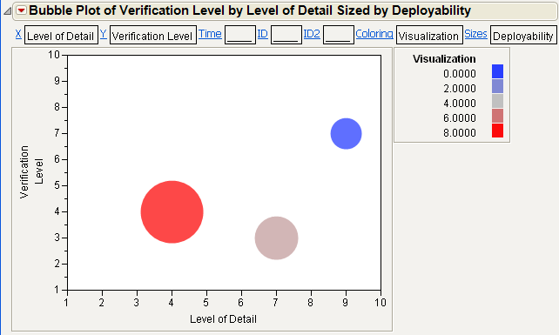
Visualize the Model Solution Space

Slide 26
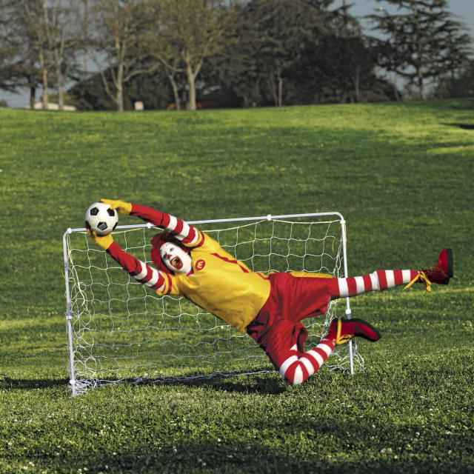
Thank You

